Slide 1
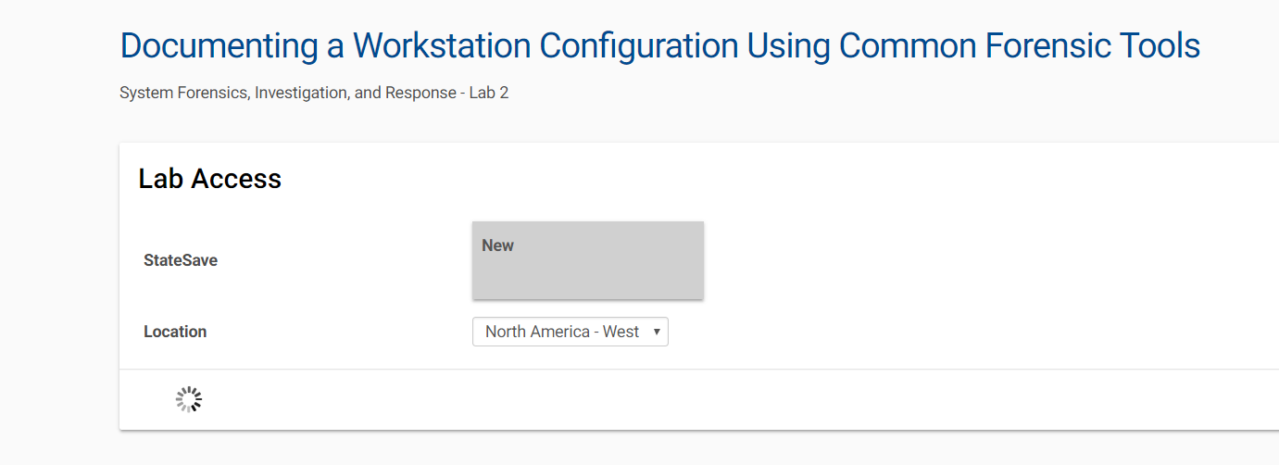
Lab Access
Notes:
Virtual Security Cloud Labs can be launched from a variety of locations. Most users will
launch their lab from the Navigate 2 platform on JBLearning.com after redeeming an
access code. Access may also be completed through a direct link in your class.
At the Launch Page for a Virtual Security Cloud Lab:
1. In the Location drop-down menu, select the location closest to your own for
optimal response times.
2. Click Start to open the lab.

Slide 2
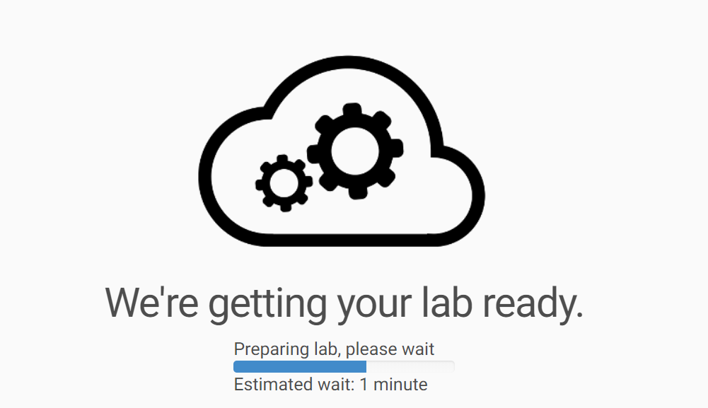
Lab Access
Notes:
You may see the following message as the system gets your lab ready.

Slide 3
Lab Document Printing
Notes:
You can click the link Common Lab Tasks Document to print a copy of the typical steps that are performed in the labs. You can follow Steps 2 through 5 (Introductions and Sections 1-3) to carry out the lab.

Slide 4
Questions?
Contact your instructor with any additional questions.
Notes:
If you have additional questions regarding the labs and the submission requirements, contact your instructor.

