Slide 1
The Skills Assessment
Copyright 2011 Ernest R. Cadotte

Slide 2
Smart Business People Know Their Numbers
In order to manage by the numbers, you need to know the numbers.
Copyright 2011 Ernest R. Cadotte

Slide 3
The Skills Assessment
Knowledge of operations, market, and competition
Integrative skills – knowledge of all functions
Ability to use of the tools of management to draw important conclusions
Awareness of firm’s SWOT
Ability to anticipate competitor moves and one’s own position in the future
Copyright 2011 Ernest R. Cadotte

Slide 4
Question Focus
Questions will focus on your firm’s internal operations, the competition, and the market.
Questions will be asked about your strengths, weaknesses, opportunities and threats.
Questions will be asked about your position in the market in Q4 and your predictions for Q5.
A number of questions will ask you for specific information on your current business.
Copyright 2011 Ernest R. Cadotte

Slide 5
Hints for Success
Players that know more about their internal operations, the competition, and the market are more likely to perform better in the simulation and in business.
Some people say that they do not need to know the details because they know where to find the information when they need it.
This is not sufficient: the more that is in your head, the more likely you will be able to make informed decisions, and thus succeed. If you do not know the details, you need to have retained the key conclusions from having analyzed the information. This is a major focus of the assessment.
The more cross-functional knowledge a team has, the more likely it will succeed. It is not enough to know your own area of responsibility. You need to have a good understanding of the other functions to be successful
Copyright 2011 Ernest R. Cadotte

Slide 6
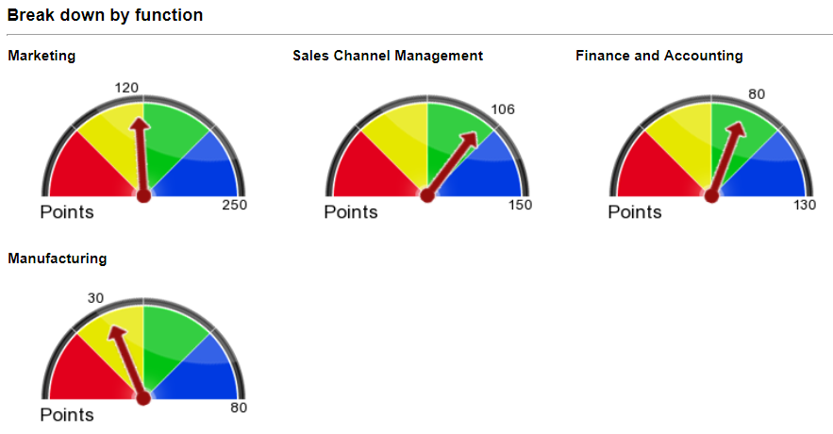
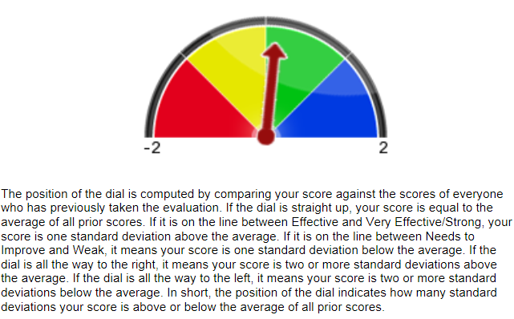
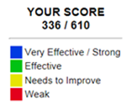
Knowledge Dashboard
Copyright 2011 Ernest R. Cadotte

