Slide 1
Unit 9 Assignment

Slide 2
Unit 9 Assignment: Introduction
A new company called Business Executive has been in business just one year with miraculous success. Their newest product, a laptop bag that has built in legs and allows the business person to simply unzip the bag and fold down the legs obviously needs some changes. Customer Service has been inundated in the last 48 hours since the launch of the new product (Product No.7) on their website. There were presales allowed for priority customers with promised arrival of their new laptop bag and stand on the day of launch in New York.

Slide 3
Unit 9 Metrics
The metrics started populating from the Eastern time zone and rolled out across the world with just a 10-15 minute delay. This company has stores in various major airports throughout the world and a website. Their call centers are located in Los Angeles, CA, Des Moines, IA, Albany, NY, and outside the United States in: the United Kingdom, Spain, Brazil, Cost Rica, France, Germany, India, Hong Kong, and South Africa.

Slide 4
Unit 9 Instructions
Follow along in the comic book to see the results of this product launch from the customer service standpoint.
At the end of the scenario, decide how you would respond to the boss and colleagues in the PowerPoint presentation. You can use any of the time zone converters available on the Internet to see what the difference is in the time zones. Your responses should be a minimum of 80-90 words for each of the six checklist items.

Slide 5


Business person on her cell phone to the customer service team day 1:
Customer #1 from New York at 12: 05 p.m.: I want you to know we practically had an accident! We were on our way to a client when all of a sudden the laptop slid over to the driver’s side…What a fiasco! You’ve got to do something about this!
CSR #1 in Des Moines,
Iowa: Don’t worry we can refund your money…
no worries…It must have been a glitch in that
particular batch of product.
We will send you back your money as a gift card
for future purchases. Thanks for calling!

Slide 6
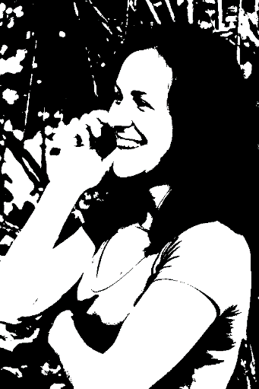

2nd call to the customer service line within minutes of the first call to Customer Service.
Customer #2 from Miami, FL at 12:15 p.m.: Hi there,
Business Executive, well I’m calling to tell you that this stand just is not good! I had it open and the laptop slid into the person’s lap who I was sitting next to on the plane… very embarrassing!
CSR #2 in Albany NY: Hi there! We have had no reports of any problems with this product. How about if I send you a new one free of charge?

Slide 7

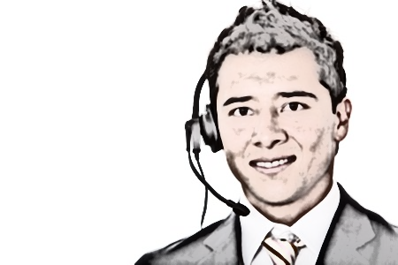
Customer #3 calls in from Dubai to the call center in Almeria, Spain.
Customer #3 from Dubai, United Arab Emirates at 8:25 p.m. (12:25 p.m. ET) What is going on? I just had a really bad experience while giving my lap top presentation to some clients as all of a sudden one of the legs on my lap top gave out and almost completely destroyed not only my presentation on my laptop, but the laptop itself. If I lose this account I am going to be really upset!
CSR #3 in Spain: I am sure this is just an anomaly, but we would like you to know we appreciate your business, and at no charge to you, we are going to send you a travel voucher to shop at any of our stores on line or at the airport for any merchandise you wish or you can get another laptop bag stand if you wish…

Slide 8
Customer #3 continues call from Dubai to the call center in Almeria, Spain.
Customer #3: That is fine, but are you going to fix this thing?
CSR #3 in Spain: Well, we will certainly be glad to fix it if you want to just drop it off at the Dubai airport store. Or, you can drop it off at any of our stores, we will replace it for you at no charge.

Slide 9
Unit 9 Results 1
Within minutes of the first 50 calls into all the customer support centers in the U.S., Costa Rica and Brazil, these were the metrics showing on the Customer Service screens when an inquiry was made by the CSR Director. Proceed to the analytics slide…

Slide 10
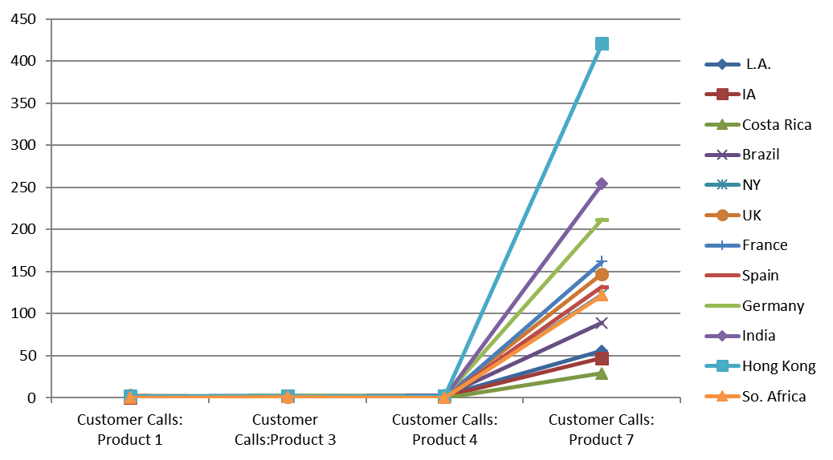
Unit 9 Results 2
12:30 p.m. ET, the company President is advised of a problem by the CSR Director. The President sends a text message to the CSR Director’s cell phone: Please advise how to handle this problem in a presentation today at 2:30 p.m. in my office with the heads of Production and Marketing.

Slide 11
Unit 9: Checklist Item 1:
The Customer Service Director receives the text and begins his analysis using his CSR tool belt: Insert your answers below in a minimum of 80–90 words for each of the six (6) checklist items.
1) The synopsis of the problem:
Priority 1:
Priority 2:
Priority 3:

Slide 12
Unit 9: Checklist Item 2:
2) Analyze the target customers’ feedback:

Slide 13
Unit 9: Checklist Item 3
3) Analyze the call center problem:

Slide 14
Unit 9: Checklist Item 4
4) Discuss how to improve customer service based on the customers’ feedback:

Slide 15
Unit 9: Checklist Item 5
5) Discuss how resolving the call center problem will improve the customer experience.

Slide 16
Unit 9: Checklist Item 6
6) Action plan:
Submit your comic book with your original responses to the Dropbox before the end of the unit. You can add a slide by right clicking on an existing slide on the left hand menu and selecting duplicate. Delete this verbiage before submittal.

