Slide 1
APA Simply Stated —APA 6th ed. (American Psychological Association, 2010)
All words you use that are written or said by another person or source must be cited in APA. It is easy once you understand it!
All citations (in-text citations) must also have an accompanying reference.
So here is what to do for in-text citations and references…

Slide 2
Steps 1 and 2:
When you are just starting out with APA, follow these simple steps:
Step 1: Introduce quotes into your writing first using such phrases as:
“According to” OR “as stated by” OR “as mentioned in”…etc.
Step 2: Add the author names (last name only) and the date in parenthesis. Example:
According to Yang, Stephenson, and Horner (2009),

Slide 3
Step 3:
Add your quote after the date and put the page in parenthesis:
According to Yang, Stephenson, and Horner (2009), “the global economic climate prevented the new venture from turning a profit” (p. 129).
Notice that the period comes after the parentheses above!
OR if no page is available, you can use the section if available (Country Briefing section) but you need to include the paragraph # (para. 4).
As stated by Yang, Stephenson, and Horner (2009), “the global economic climate prevented the new venture from turning a profit” (Country Briefing Section, para. 4).

Slide 4
Website In-Text Citation and Reference :
In-text citation for a quote from website magazine-no author:
As an example of valid research, no better source is offered beyond University databases (“Sources cited,” 2002). Note: When there is no author, use the first few words of the article title as seen above with “Sources cited”. You will also use these first words in place of the author name(s) for your reference as well as seen below.
References
Sources cited concerning writing. (2002). Retrieved April 21, 2002 from http://www.newsmagazinewriting.com
Note: Remember to use the URL at PG instead of the doi, and
remove the hyperlink to the URL by right clicking on it and selecting
remove hyperlink.

Slide 5
Example of In-Text Citation for a Paraphrase
When there are several authors:
Original quote: In a research study by Horner, Ferrell, and Crestfall (2014), they stated that “the BRIC countries were no longer growing at the blistering rate of years 2007–2011”(p. 309). Note the use of the word, “and” in the in-text citation instead of an ampersand when the authors names are not in parentheses.
Paraphrase of the above quote:
Recent research has shown that countries that formerly were considered to have fast growth economies in the first decade of the twenty-first century have reverted to slower growth
(Horner, Ferrell, & Crestfall, 2014) after the global economic
slow-down. Note the use of the ampersand in the in-text citation when in parentheses above.
The accompanying reference (on the references page) for either of the above can be seen on the next page.

Slide 6
References
Horner, C. K., Ferrell, P.R., & Crestfall, A. (2014). Brazil, Russia, India, and China: Fallen angels of economic growth. Journal of Economic Growth, 27(9), 309–409. Retrieved from http://www. journalofeconomicgrowthpretendurl.org

Slide 7
Example of a Paraphrase Citation and Reference
Example of a paraphrase citation and reference (if there is no individual author, only an organization or institution, and no page number): Original quote:
According to the State University of Michigan (2010), “China has been second in terms of the market potential index in the world.” (Market Potential Index section, para. 2).
Paraphrase:
According to the State University of Michigan (2010), China has been ranked competitively together with the top five countries in terms of having a favorable market for business in the coming decade (Market Potential Index section, para. 2).
Reference:
State University of Michigan. (2001-2010). Market potential index.
Retrieved from http://globaledge.msu.edu/resourcedesk/mpi/

Slide 8
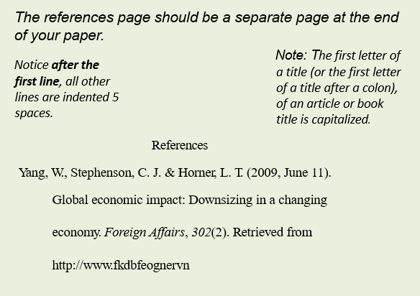
References Instructions and Example

Slide 9
References Examples Continued
References
Cleister, H. L., & Fetter, C. M. (2011). Synopsis revisited
(4th ed.). Journal of Examples to Students, 23(4),
130–142. Retrieved from http://www.48305yu3o5h
Notice that the name of the journal and volume #
above are italicized, but the issue (i.e., 4) is not.
See more references examples by scrolling down to the next page.

Slide 10
References for a Book or Website
For a book:
Hill, C. W. (2009). Global business today (6th ed.). New York, NY: McGraw- Hill Irwin.
For a website:
U. S. Census Bureau. (2010). IDB: Argentina. Retrieved from http://www. census.gov/ipc/www/idb/informationGateway.php

Slide 11
Conclusion:
See? It is not that difficult! Soon you will be a pro!
For additional help, go to the Academic Tools area of the course.

Slide 12
Reference
American Psychological Association. (2010). Publication manual of the
American Psychological Association, (6th ed.). Washington, DC: Author.
[Note the Association is the author and publisher in this case.]

