Slide 1
Unit 6 Assignment Template
[Your Name]
[Course and Section Number]
[Date]
[Instructor’s Name]

Slide 2
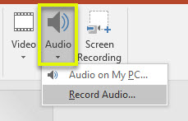
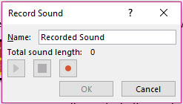
Adding Audio to Slides – NOTE: Remove this slide before uploading final PowerPoint to Dropbox
After writing the content for each slide, add the audio explanation. Each explanation should be 2 minutes long.
Click on the “Insert” button in the top menu of this PowerPoint window.
2. Click on the dropdown arrow on the audio button and choose “Record Audio”.
3. Use the audio stop, play and record controls to record your announcement.
4. Your recorded announcement will be embedded on the slide.
5. Save the file and upload to the Dropbox once all criteria are completed.

Slide 3
Introduction
[Name of organization]
[Type of organization]
[Date and time of observation]
[Your role as observer (employee, customer, client, etc.]

Slide 4
Professional Appearance of Employees and Company
[Use these questions to guide your narration response:
How do the employees dress?
Is there anything about the appearance of the employees that distracts from their professionalism?
Do the employees’ appearance fit the nature of the business? Why or why not?
What does the working environment look like? (furnishings, artwork, lighting, sounds, etc.)
Do the physical surroundings fit the nature of the business? Why or why not?
How do the employees interact with each other and outside people within the workplace? (greetings, tone of conversation, non-verbal communication, etc.)
How do employees interact with each other?
Do the interactions of employees fit the nature of the business? Why or why not?]

Slide 5
Analysis of Company
[Discuss: What inferences can you make from your observation?] You should cover the following ideas in your explanation:
Analyze the company based on information you have learned about organizational culture in the class. Areas to include are to
categorize the type of organizational culture you feel the company follows and support this information with what you have learned about organizational culture
compare the work done at the company and the organizational culture and explain how this relates
research the mission of the company and explain if it aligns with what you have observed. Explain why or why not.

Slide 6
Evaluation of Your Fit
[Discuss: Based solely on what you have observed and researched about the company (not based on the field of the company), do you feel you would be a good fit for this company? Why or why not?]
NOTE: Support this information with what you have learned through your observation as well as what you have researched about the company.

Slide 7
References
APA formatting guidelines apply for both the reference slide and in-text citations to support research required for the assignment.

